Slide 1
Paper Reading
金旭
2018-3-30

Slide 2
AMRMF
Adapative Manifold Regularized Matrix Factorization for Data Clustering
Author : Lefei Zhang, Qian Zhang, Bo Du, Jane You, Dacheng Tao

Slide 3

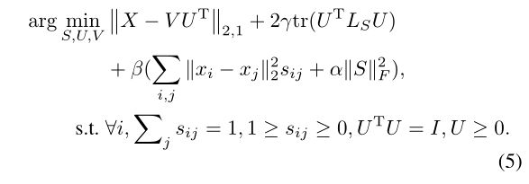

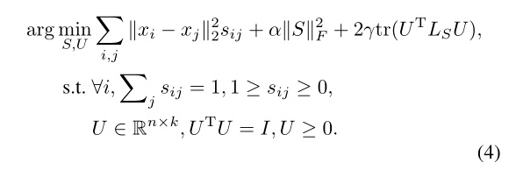
AMRMF
Method
Original NMF：
Use L2,1 norm：
Add similarity constraint:
Combine (2) and (4) together：

Slide 4
AMRMF
Others
Most of exist methods directly introduce the Gaussian kernel derived Laplacian matrix for manifold regularization, while ignore to explore a more meaningful affinity matrix to better regularize the model.
The standard NMF uses the L2-norm based squared residue minimization to measure the loss, which would be easily effected by the noises and outlines.
Advantages
In a matrix factorization point of view -> scalable and reproduceable
Jointly learns an affinity matrix with the matrix factorization
Employs the L2,1-norm to measure the loss of matrix factorization.

Slide 5
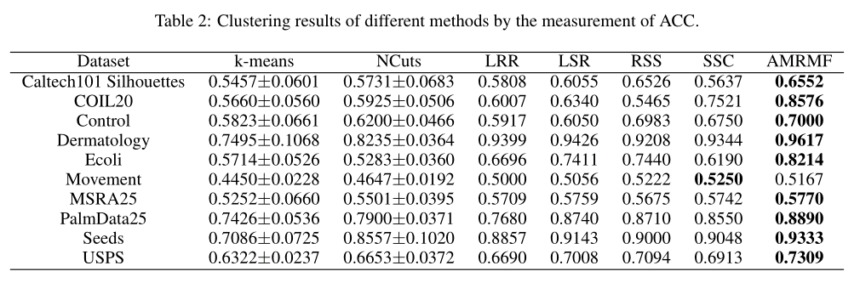
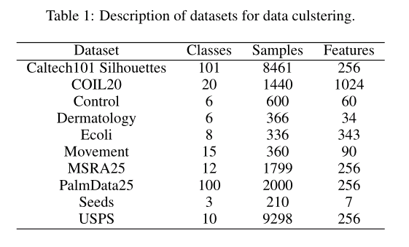
AMRMF
Experiment
Measurements :
Clustering accuracy (ACC)
Normalized mutual information(NMI)

Slide 6
AMRMF
What we can learn : Use L2,1 norm instead of L2 norm ,which is more unsensitive to noise

Slide 7
MCNMF
Multi-Component Nonnegative Matrix Factorization
Author : Jing Wang, Feng Tian, Xiao Wang, Hongchuan Yu, Chang Hong Liu, Liang Yang

Slide 8













MCNMF
Method
Original NMF：
Represent X by V component simultaneously：
Enforce different component independent from each other by HSIC:
Use inner product kernel for HSIC and ignore the coefficient:
Final iteration function:

Slide 9
MCNMF
Advantages
It captures more comprehensive information and interprets data from different perspectives, by leveraging the multiple components. Instead of factorizing the data matrix into a single basis and representation matrix, MCNMF learns multiple representations based on different basis matrices.
HSIC explores the diverse information among the representations, where each representation corresponds to a component.

Slide 10
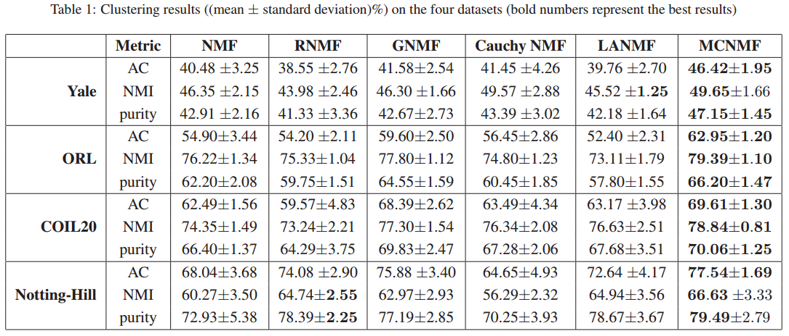
MCNMF
Experiment
Measurements : Accuracy (AC), Normalized mutual information(NMI), Purity

